Slide 1
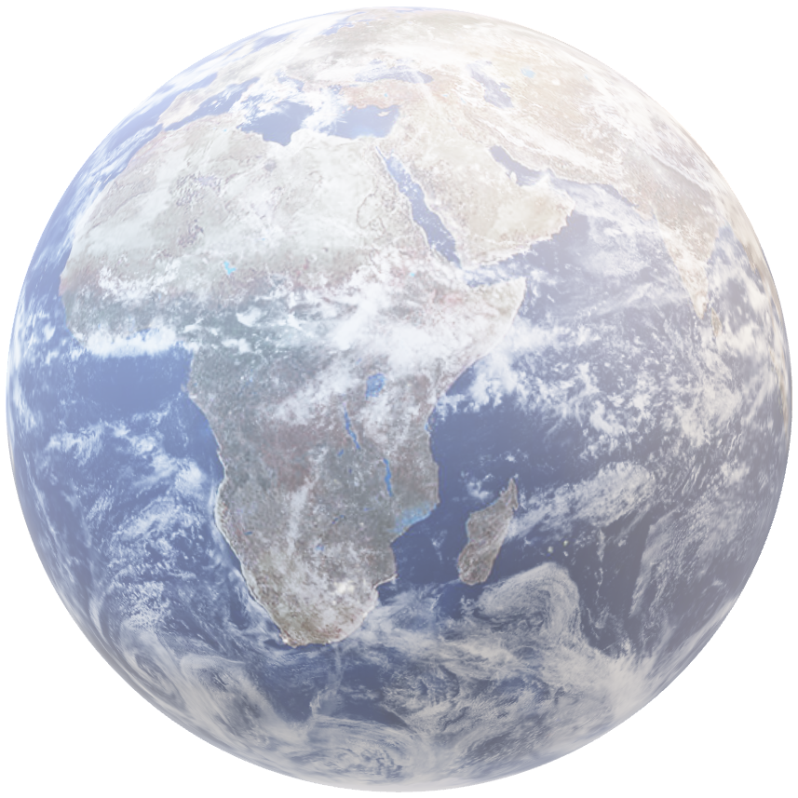
Mandeep
Patrick
Iarsolav
Amrit

Slide 2

ExoPredict
Classifying and Predicting
Exoplanet Characteristics
Mandeep
Iarsolav
Amrit
Patrick

Slide 3

Overview
The 76th International NASA Conference, scheduled to be held in Sydney in 2025, marks a significant milestone for the country and serves as an inspiring catalyst for exploration in space science and technology.
By utilizing advanced analytics, we aim to contribute a data-driven perspective to the exciting developments surrounding this prestigious event.

Slide 4

Introduction
In this presentation, we delve into a comprehensive dataset connected to the conference, leveraging data analytics to uncover valuable insights.

Slide 5
Introduction
As the name suggests, we tried to play with dataset collected by NASA over the years about some fascinating star systems around us and the planets orbiting around those stars, also known as Exoplanets. We hope to quench our thirst of knowledge by analysing these datasets.

Slide 6

ETL Process

Slide 7

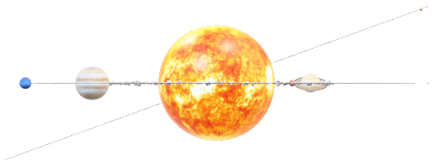
Data Analysis

Slide 8
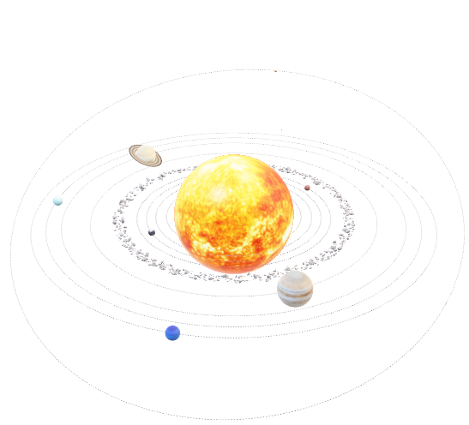
Data Analysis

Slide 9
How do planetary characteristics influence the likelihood of being in the habitable zone? (Mandeep)

Slide 10

2. How does a planet’s orbit impact its temperature and potential habitability?(Mandeep)

Slide 11

Q1 & Q2: Classify planets by insolation, temperature, mass, coordinates with regards of available planets (Iarsolav) Complete dataset, it'll be helpful to draw graphics with stars located across sphere (Iarsolav)

Slide 12

Q1 & Q2: Classify planets by insolation, temperature, mass, coordinates with regards of available planets (Iarsolav) Complete dataset, it'll be helpful to draw graphics with stars located across sphere (Iarsolav)

Slide 13
Question 1: Can we identify groups of similar exoplanets? Analysis: Apply clustering algorithms (e.g., K-means, hierarchical clustering) to group planets with similar characteristics. Question 2: Can we classify planets into different categories (e.g., rocky planets, gas giants) based on their properties? Analysis: Use supervised learning algorithms to classify planets based on features such as mass, radius, and temperature.

Slide 14
Question 1: Can we identify groups of similar exoplanets? Analysis: Apply clustering algorithms (e.g., K-means, hierarchical clustering) to group planets with similar characteristics. Question 2: Can we classify planets into different categories (e.g., rocky planets, gas giants) based on their properties? Analysis: Use supervised learning algorithms to classify planets based on features such as mass, radius, and temperature.

Slide 15
Is there a correlation between specific discovery facilities and the methods they use to detect exoplanets, and how does this impact the types of planets discovered?
How does the distance of a planet host from its exoplanets influence the exoplanets' temperature, luminosity, and color, and what patterns emerge across different star-planet systems?

Slide 16
Is there a correlation between specific discovery facilities and the methods they use to detect exoplanets, and how does this impact the types of planets discovered?
How does the distance of a planet host from its exoplanets influence the exoplanets' temperature, luminosity, and color, and what patterns emerge across different star-planet systems?

Slide 17
Conclusion

Slide 18

Thank you!

